Slide 1

Data Science Final Project
Group members:
Bashir Alam
Mirzonabot Mirzonabotov

Slide 2
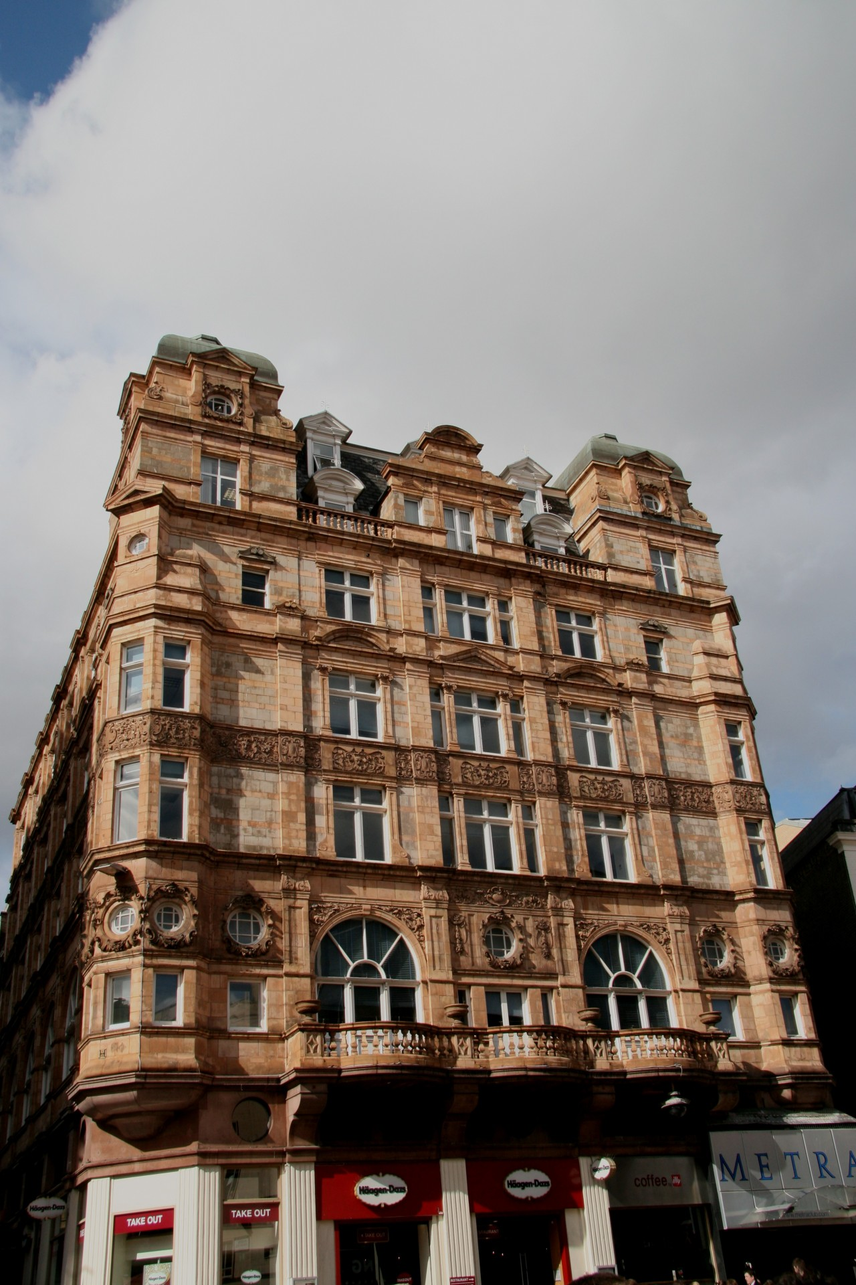

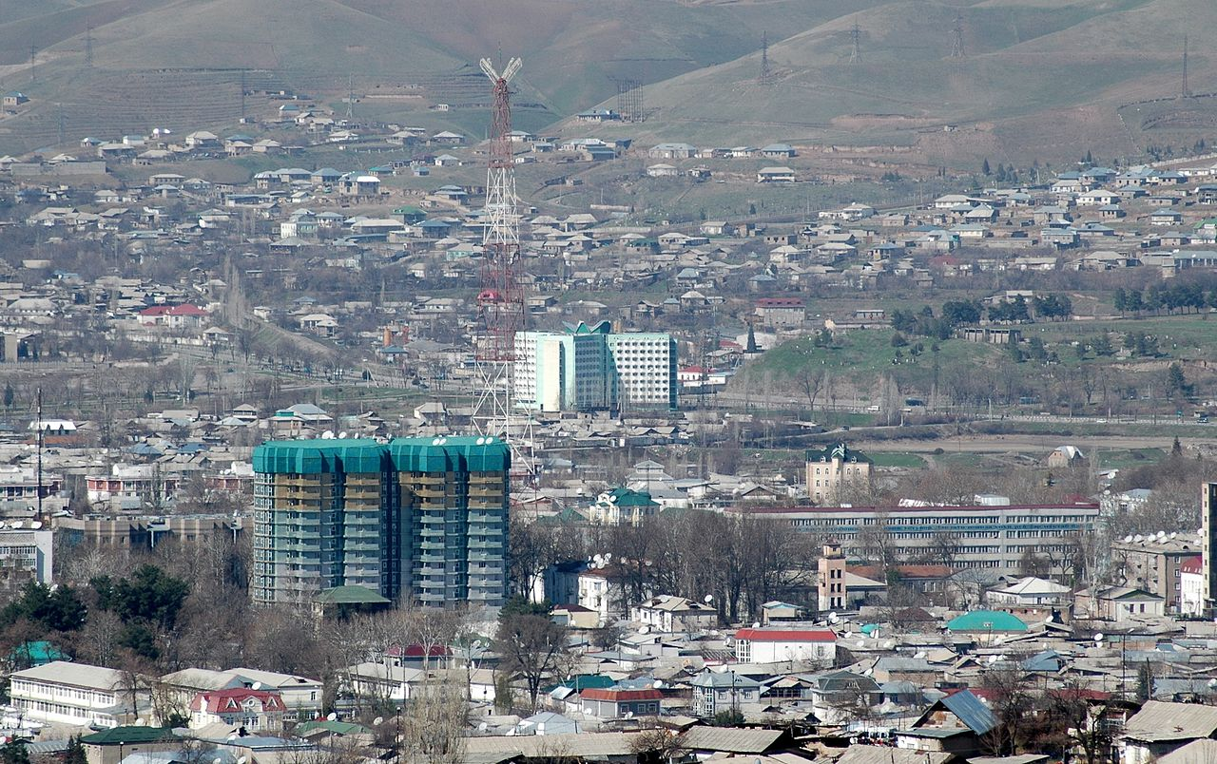
Problem statement
Housing price in cities (Dushanbe)
Average price of an apartment in Dushanbe
This Photo by Unknown Author is licensed under CC BY-ND
Based on the
Location
Number of Rooms
Area
Address
This Photo by Unknown Author is licensed under CC BY-SA

Slide 3


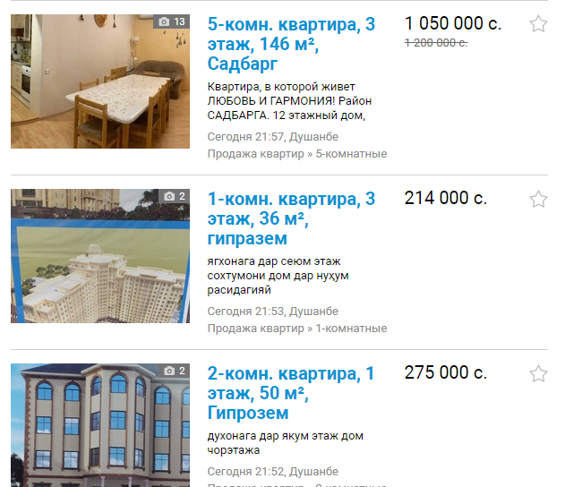
Available tools

Slide 4
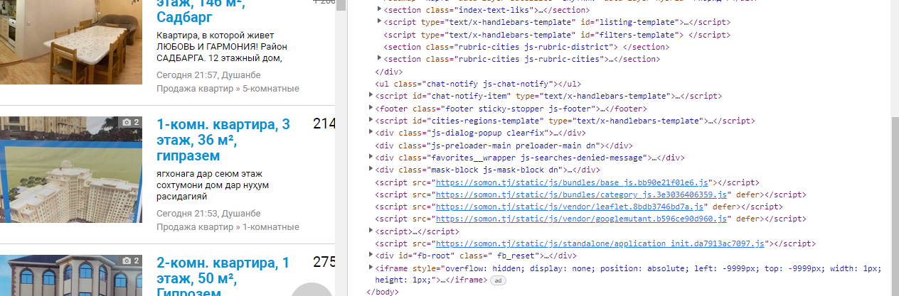
Data collection
Using Python to scrape data from somon.tj

Slide 5
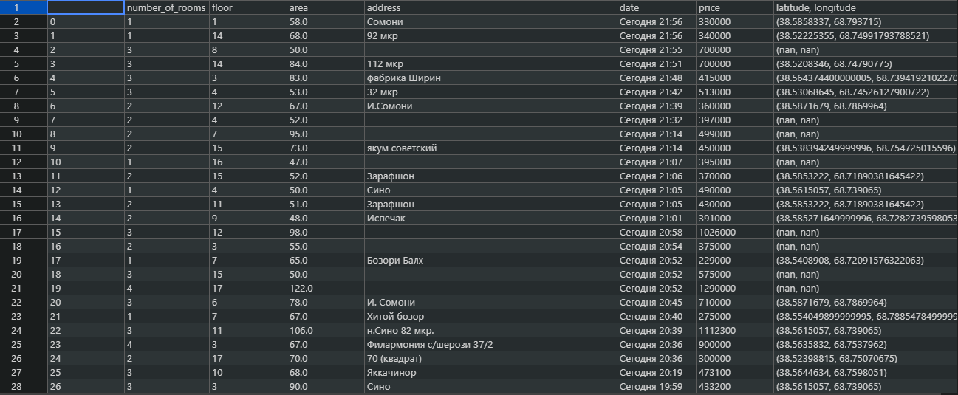

Slide 6
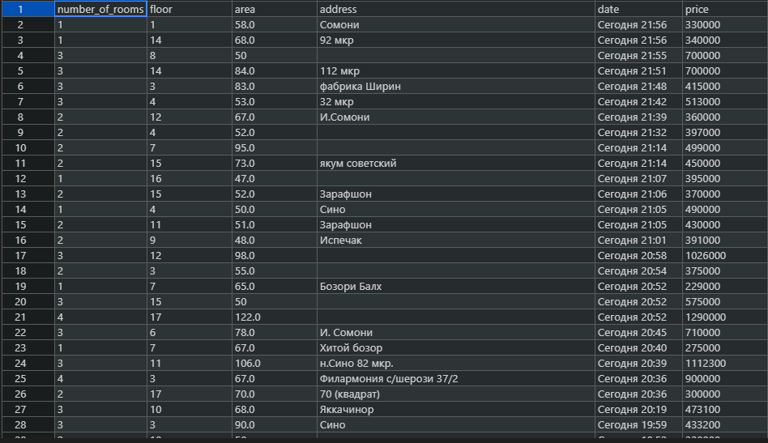

Slide 7
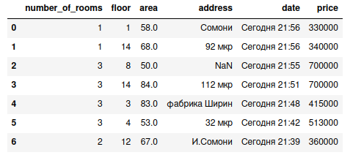
Data preprocessing and analysis
1. Drop data column
2. convert address to latitude and longitude
3. Remove null values

Slide 8
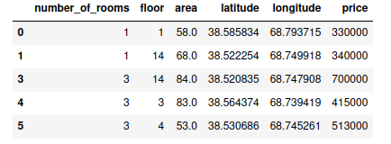
Pre-processed Dataset

Slide 9
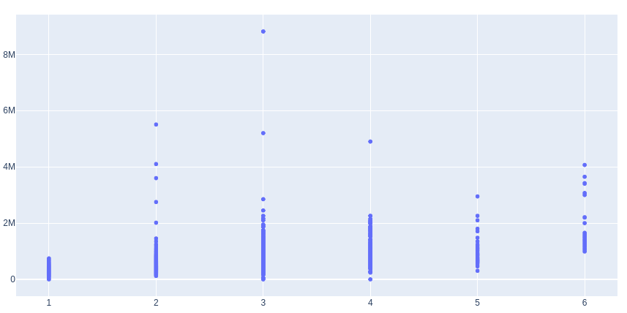
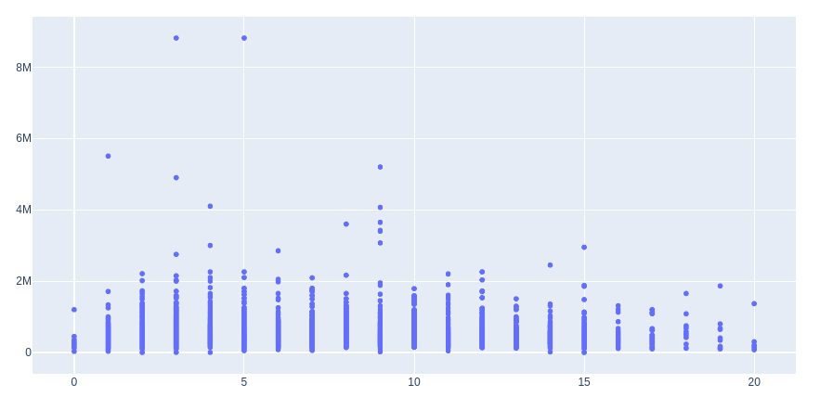
Visualization of data
Price
Price
Number of rooms
Floor

Slide 10
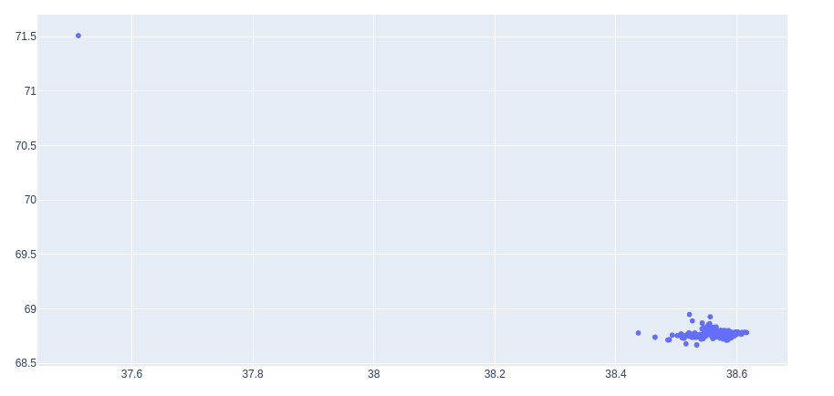
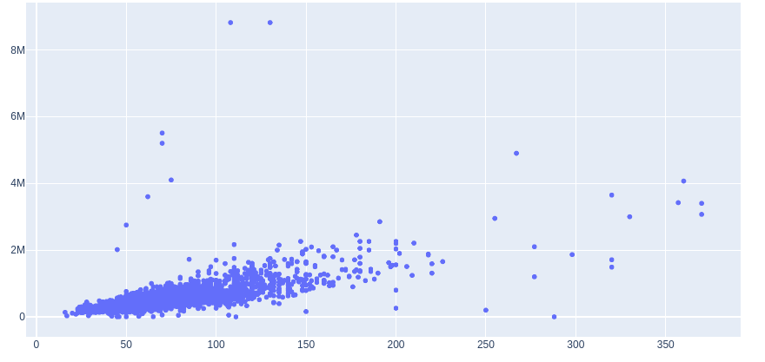
Visualization of Dataset
Price
Longitude
Area
latitude

Slide 11
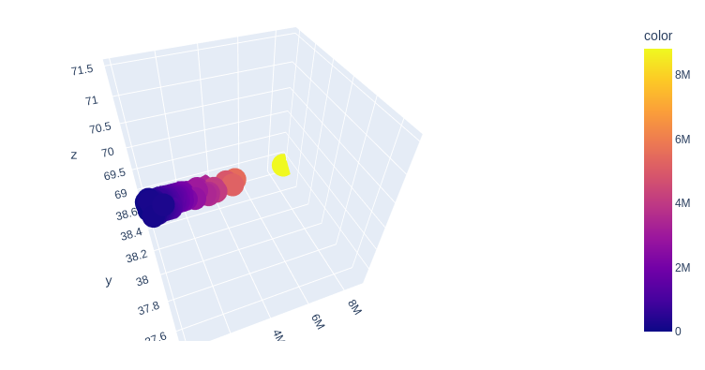
3-plot of area vs price

Slide 12
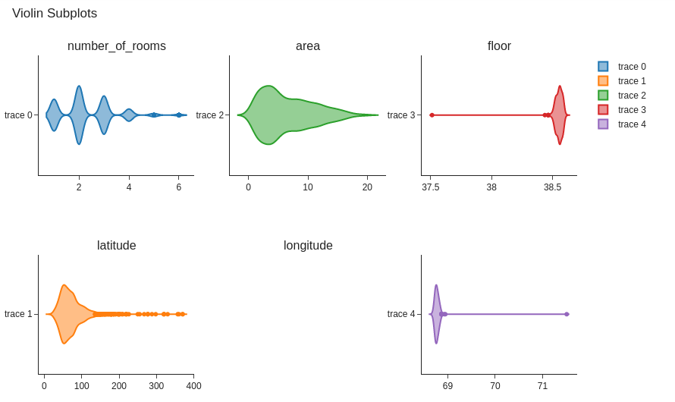
Data distribution and probability

Slide 13
Applied Algorithms
Three Algorithms
Multi-Regression
Extreme Gradient Boosting (XGBoost)
Artificial Neural Network (ANN)
Why these models
Output is continuous
Have multiple variables
Dataset contains complex non-linear relationships

Slide 14
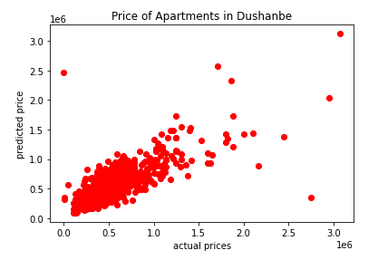
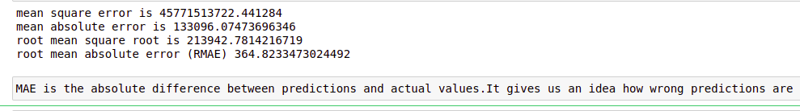
Multi-Regression
Predicting an outcome (dependent variable) based upon several independent variables simultaneously.
Reasons: Dataset have 5 independent variables and one dependent variable, Output is continuous, We wanted to know affect of multiple independent variables on output (price)
Parameters: constant term, Y-intercept, coefficients of variables

Slide 15
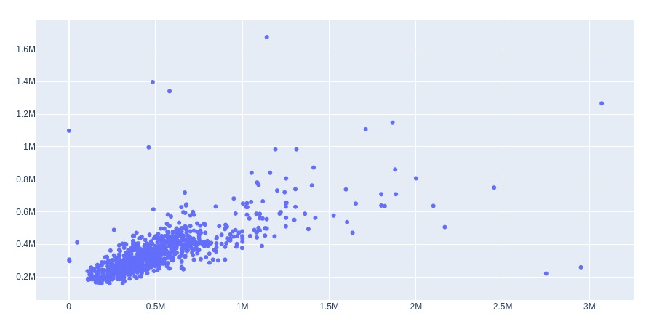
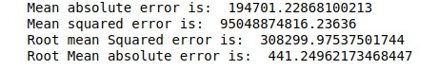
XGBoost
XGBoost is an optimized distributed gradient boosting library designed to be highly efficient, flexible and portable.
Reasons: applies on regression, it combines many algorithms and chose one having least error.
Parameters: learning rate means how fast model learns and we chose 0.1, linear model.

Slide 16
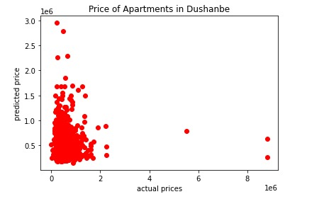
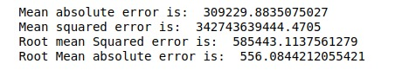
Artificial Neural Network (ANN)
Group of algorithms that certify the underlying relationship in a set of data similar to the human brain.
Reasons: works for continuous values, it works better for complex non-linear relationship
Parameters: number of hidden layers, the number of neurons per layer, the number of training iterations.

Slide 17
Comparison of Models
RMAE of Multi-Regression = 364.8
RMAE of XGBoost = 441.3
RMAE of ANN = 556.9
Scatter plot of Multi-Regression is also good. It is very close to the best fit line
Data is scattered less in Multi-Regression compared to XGBoost and ANN
Less outliers in Multi-Regression

Slide 18
Suggestion
If someone wants to do this project later then we would recommend to find a way to suggest the user top five apartments which would match his/her search.
It will be user friendly as he will not have to search again and again

Slide 19

Thank you!

